Slide 1
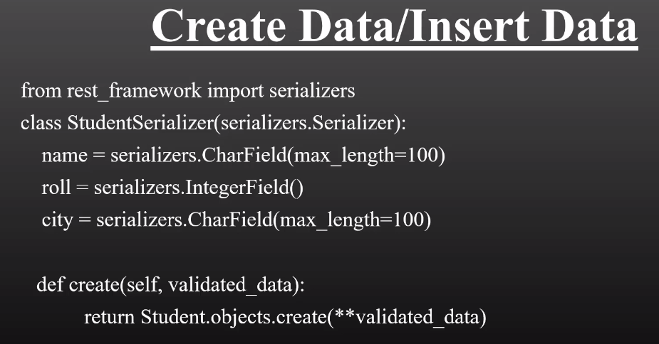
CRUD API
Create and Insert Data:

Slide 2
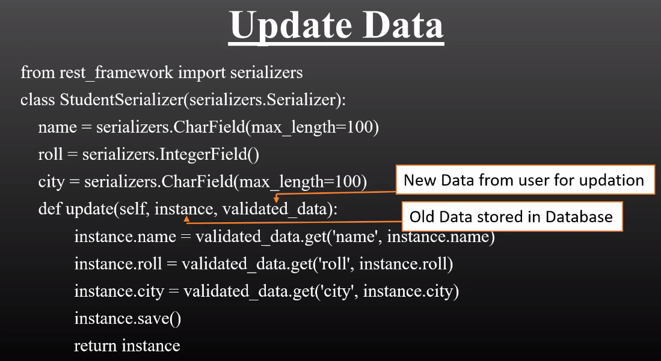
Update Data

Slide 3
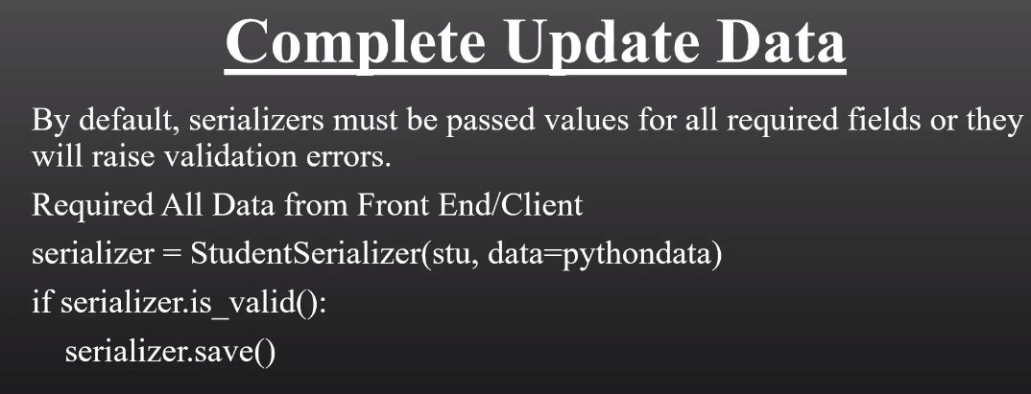

Slide 4


